Slide 1
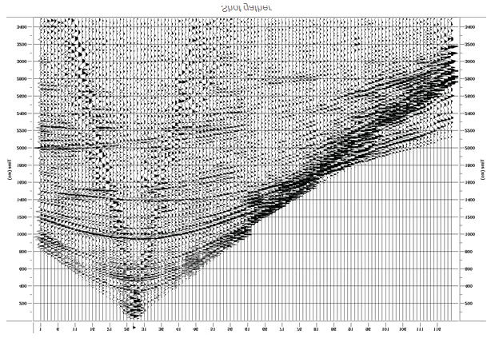
Seismic reflection data Lecture 3
Dr Rebecca (Becky) Bell and Raul Adriaensen
2nd floor, office 2.37a
rebecca.bell@imperial.ac.uk

Slide 2
Module outline
Day 1 morning- Introduction to seismic data
Lecture 1: Physical principles
Lecture 2: Data acquisition
Lecture 3: Key data processing steps
Day 1 afternoon- Exercises
Exercise 1: Synthetic seismic models
Exercise 2: Viewing “raw” data gathers and conducting NMO corrections and velocity analysis
We will discuss the “solutions” to the exercises during the afternoon sessions (and these will be recorded)

Slide 3
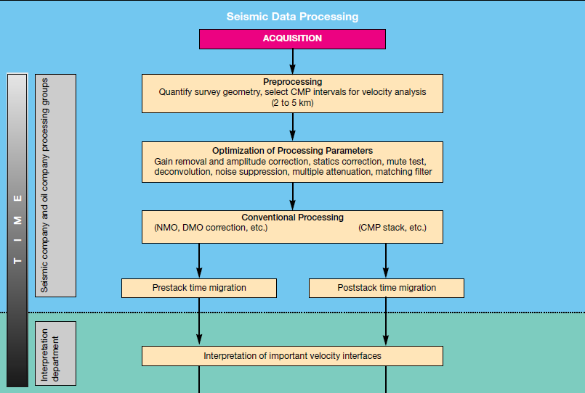
Processing workflow
In this course we are just going
to cover the key processing steps needed to go from raw shot gathers to ‘stacked’ data
Farmer et al. 1994

Slide 4
Lecture outline
Objectives of lecture 3:
Learn how raw data recorded by geophones/hydrophones is
processed to produce seismic reflection images
CMP gathers
2) Normal Moveout corrections
3) Velocity analysis

Slide 5
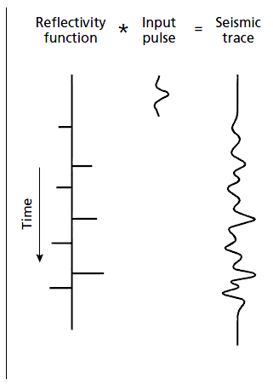
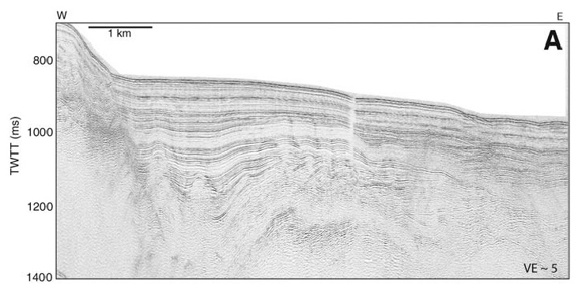
Creating a seismic section....
Seismic section
In order to create a seismic section from seismic traces requires a significant amount of processing

Slide 6
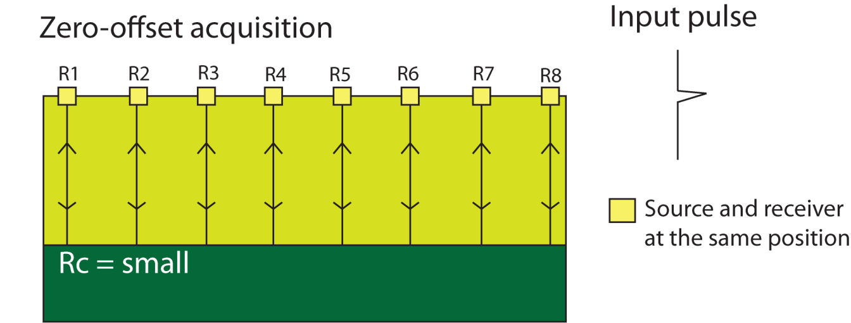
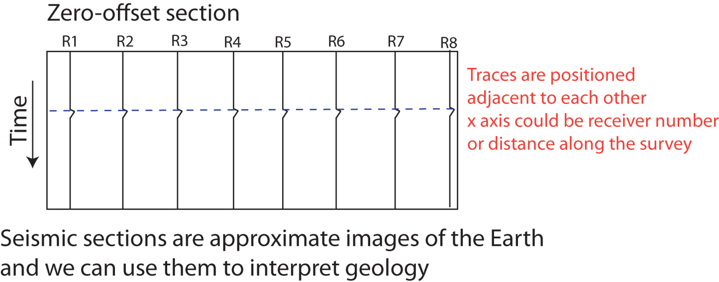
Zero-offset survey
The easiest way to create a SEISMIC SECTION is to conduct a zero-offset survey:
Rc = +’ve
Shot
Record
The problem is, reflection coefficients are very small, so the reflections have low amplitude

Slide 7
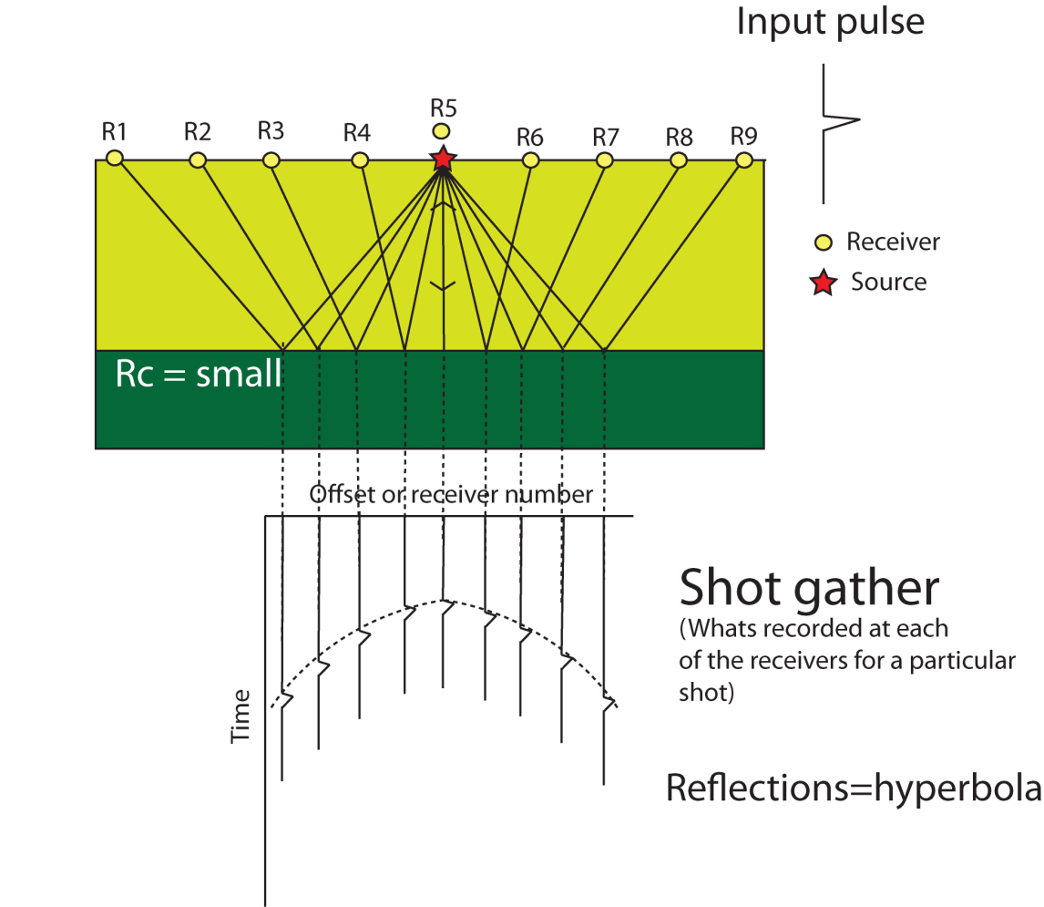
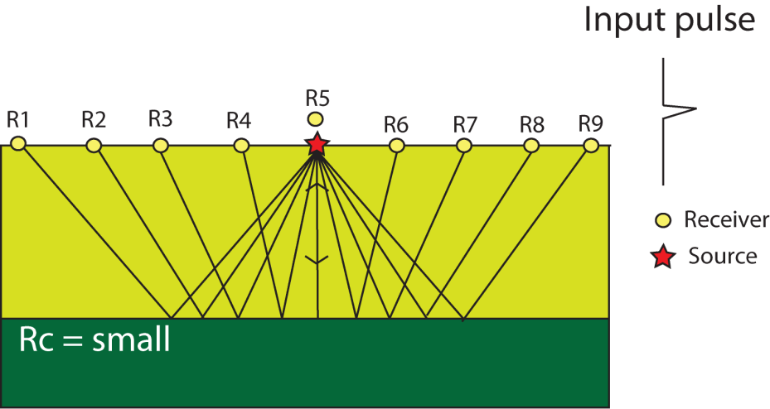
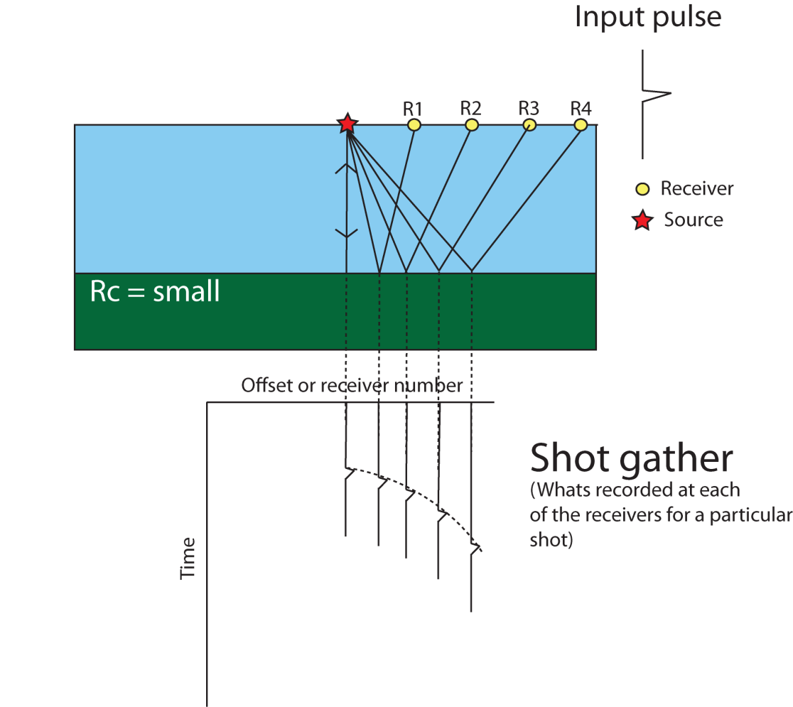
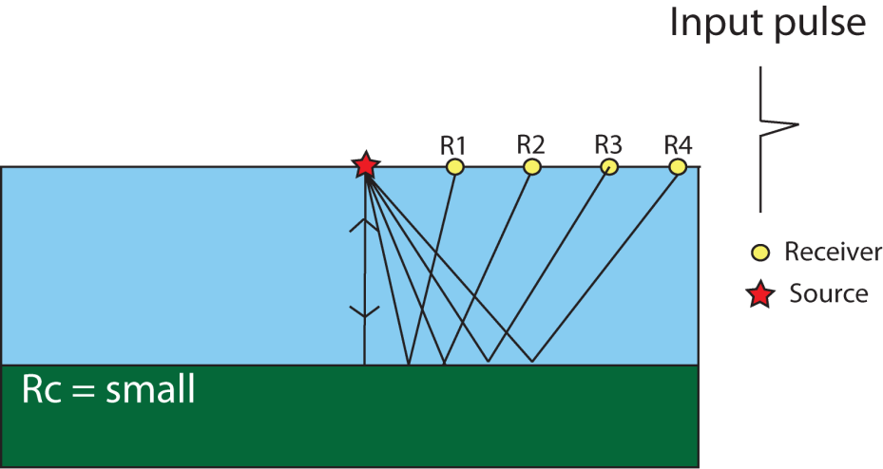
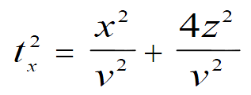
Shot gathers
For any shot (on land or at sea) we could place the traces detected at each receiver adjacent to each other- this would produce a SHOT GATHER (raw data)
On land:
At sea:

Slide 8
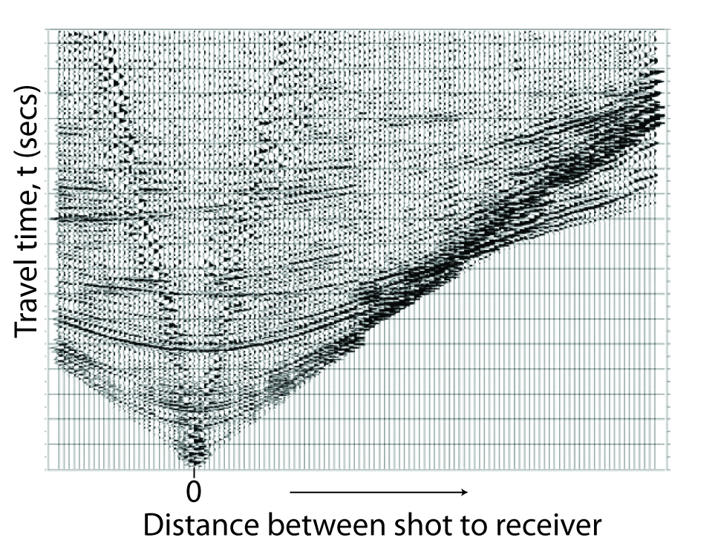
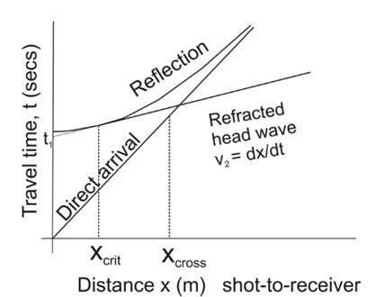
Shot gathers
Shot Gather
Refracted
head wave
Reflection
Direct arrival
Seismic traces from a single shot are grouped together to form a shot gather

Slide 9
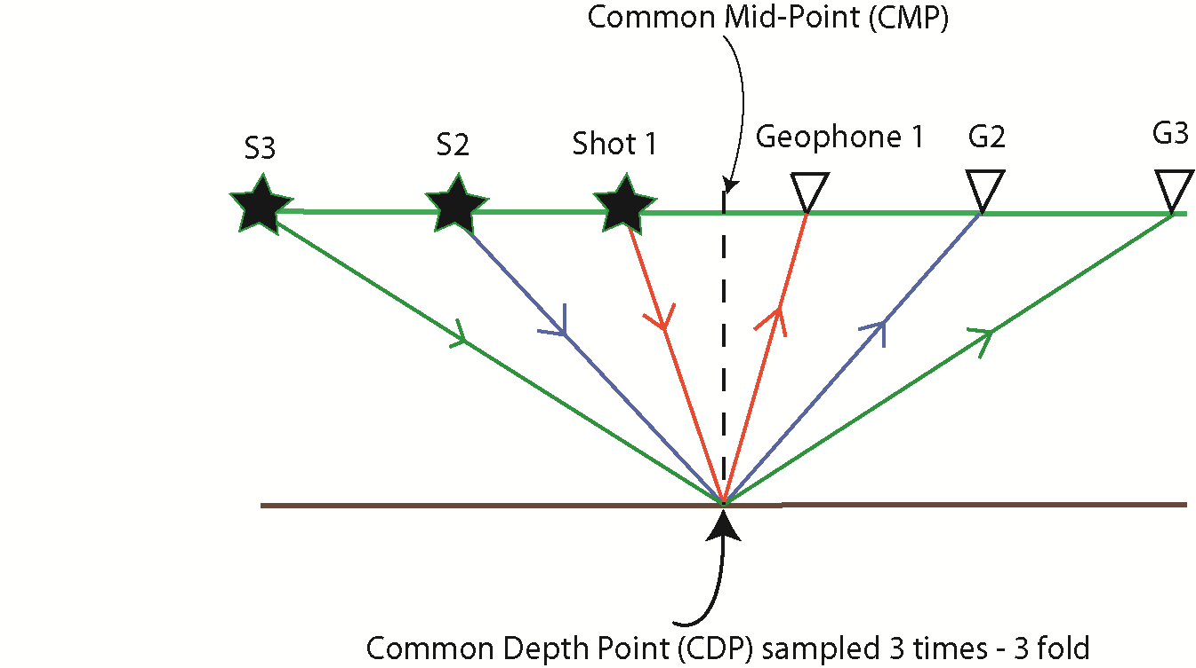
Common mid-point gathers
We design seismic surveys so points in the sub-surface are sampled more than once
We arrange traces into Common- Mid-Points (CMPS; also sometimes called Common Depth Points, CDPs)
This allows us to improve our signal to noise ratio (S/N) by stacking traces with the
same CMPs.
This is a key, fundamental idea behind the seismic reflection technique

Slide 10
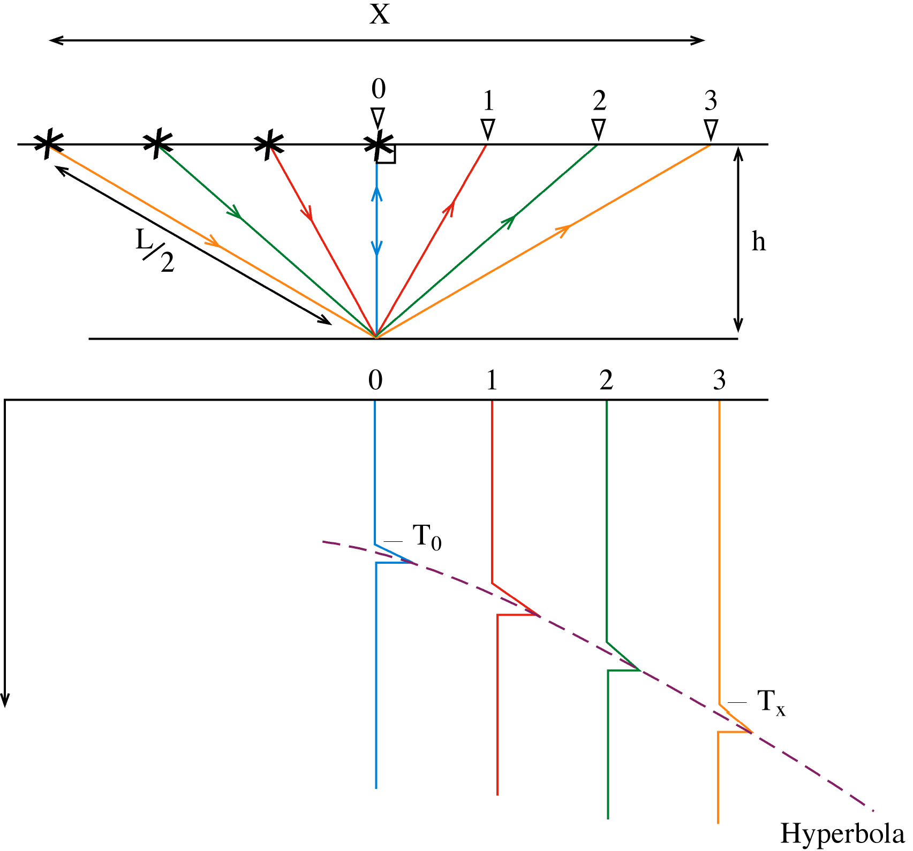
CMP gathers and Normal Move-Out
Normal Move-Out (NMO) is a correction for increasing TWT with source-receiver offset.
Applied on each CDP gather before stacking.
Receiver number (or offset)
CMP
gather
Time
Sometimes called “hyperbolic moveout”

Slide 11
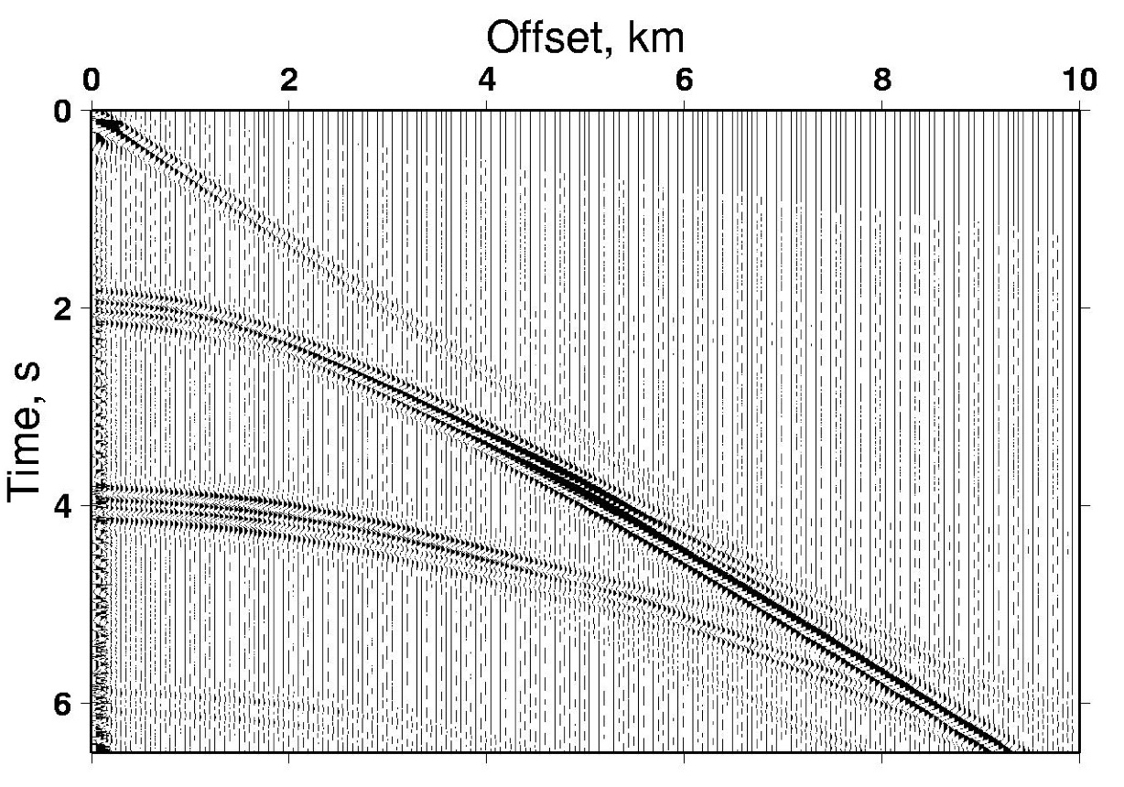
Reflection Move-Out

Slide 12
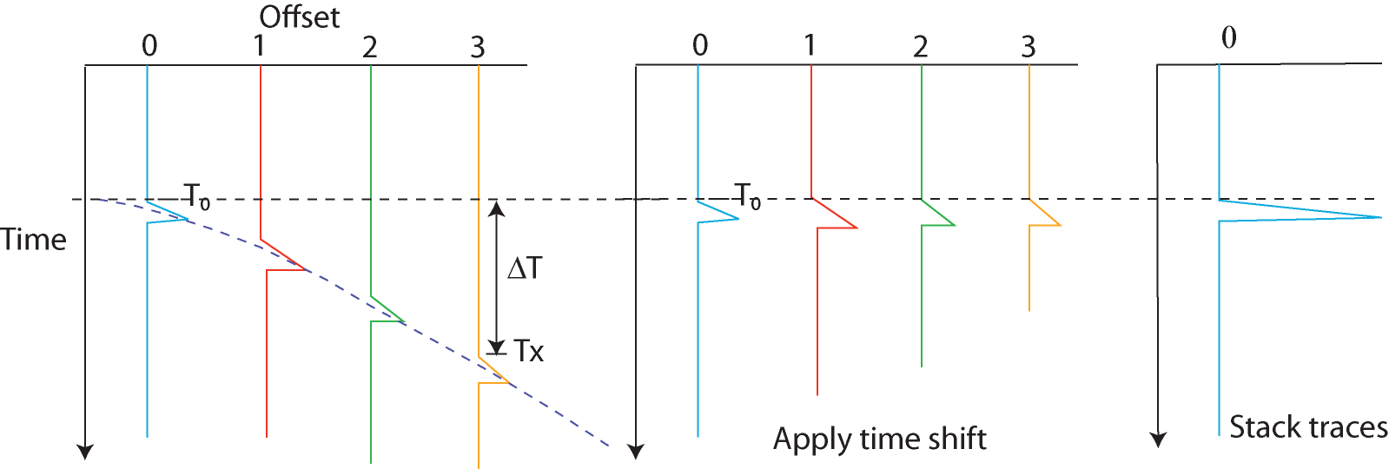
Normal Move-Out
Stacked trace
STACKING

Slide 13
Normal Move-Out
Stacked trace
STACKING

Slide 14
Normal Move-Out
Setting X = offset, L=path length (in m), h=depth (m), T₀ = TWT at zero offset, and T_{X} = TWT at offset X. Pythagoras allows us to calculate:
We’re working in time, so:
Hence:
Time

Slide 15
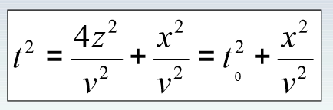
Normal Move-Out
Setting X = offset, L=path length (in m), h=depth (m), T₀ = TWT at zero offset, and T_{X} = TWT at offset X. Pythagoras allows us to calculate:
We’re working in time, so:
Hence:
Time

Slide 16
Normal Move-Out
This is the equation of a hyperbola, whose shape is controlled by V.
For the NMO, we want to apply a static time shift that approximates:

Slide 17
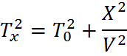
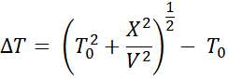
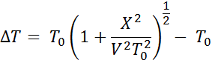
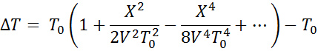
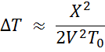
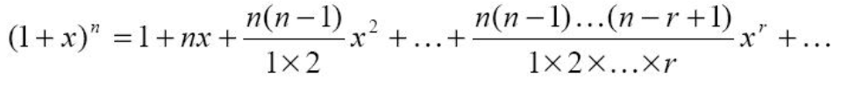
Normal Move-Out
Substituting T_{X} from before gives:
Binomial expansion:
Because X/Vto <<1

Slide 18
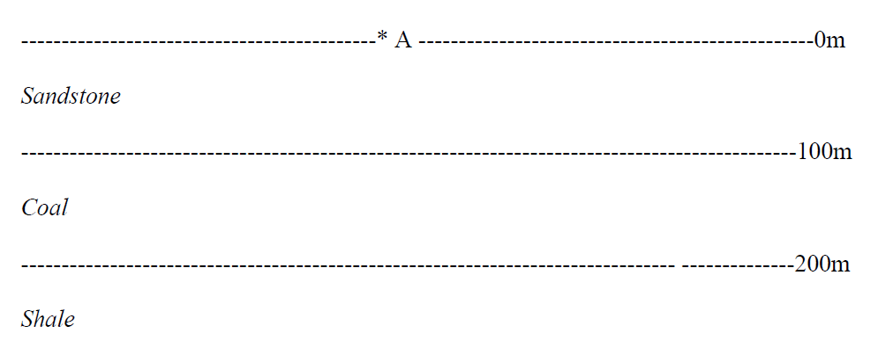
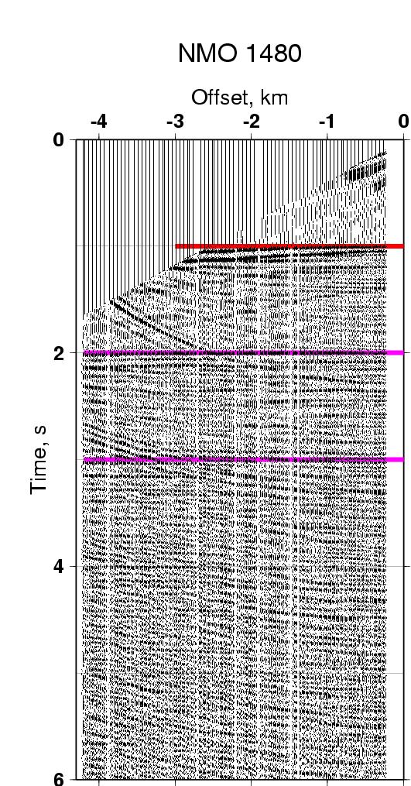
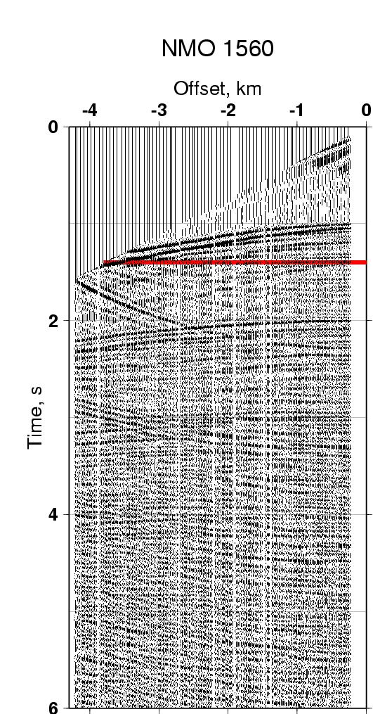
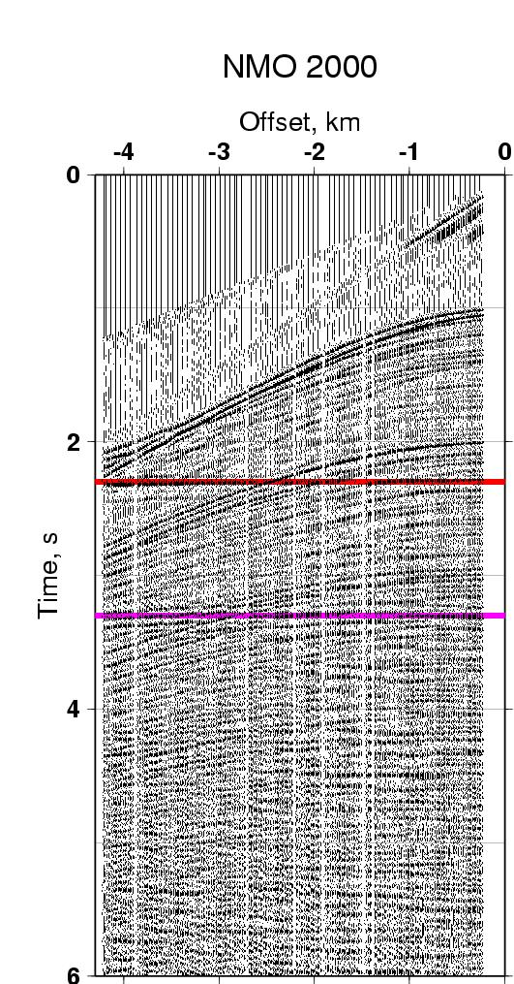
Velocity dependence
air
Multiples- often have surprisingly low
NMO velocity for their depth

Slide 19
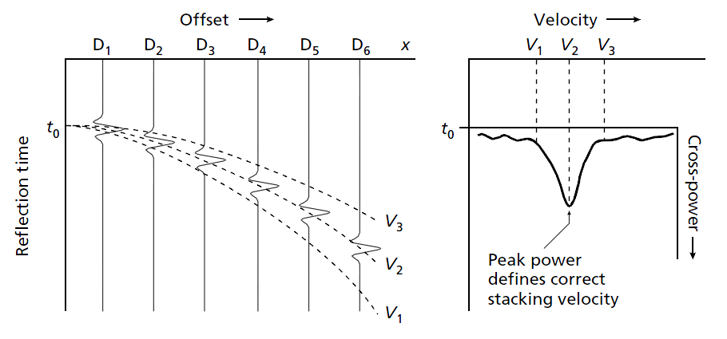
Stacking velocity
In practice, NMO corrections are made for a range of velocities and corrected
traces stacked
Kearey, Brooks & Hill
Semblance plots measure the amount of seismic energy present in stacked traces

Slide 20
Velocity dependence

Slide 21
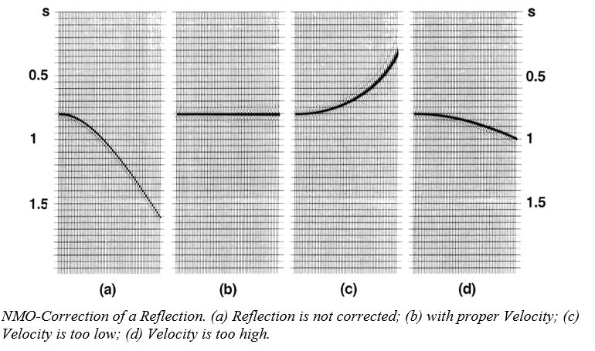
Before NMO
..V is just right
…V too low
…V too high
http://www.bairdpetro.com/pdf_files/p58-62.pdf

Slide 22
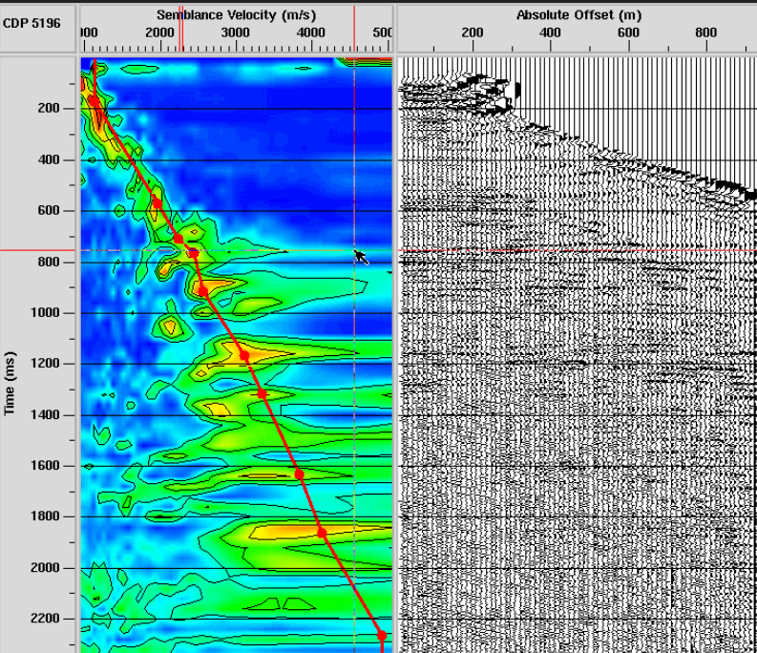
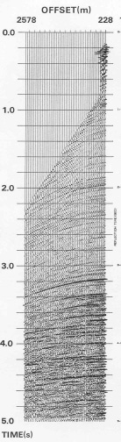
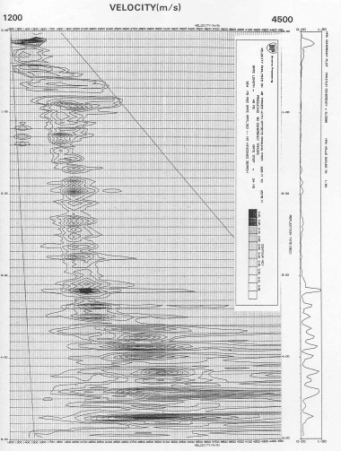
Semblance plots
A velocity spectrum is used to determine the correct stacking
velocity to use, as a function of reflection time
The cross-power function (semblance) is calculated over a
large number of narrow time windows down the seismic trace,
and for a range of velocities for each time window
Kearey, Brooks & Hill
Dragoset, 2005 (paper on ESESIS- I recommend you take a look)

Slide 23
Exercise 2
You will investigate how to select the correct velocities for NMO
corrections of both synthetic and real CMP gathers
Velocity analysis is another of those areas of seismic data analysis which is still quite manual, and automation can very likely make a real impact.
Velocity is really important in seismic data analysis to i) convert seismic data from time
to depth on the y-axis, ii) perform key processing steps like NMO and migration (we will talk about this briefly next) and iii) velocities can give you some information about rock types and physical properties

Slide 24
Some other processing step examples:
There is a lot more to seismic data processing. Geophysics students will have full modules just in this topic and many geoscientist have made their careers in this field. We only scratch the surface.
Here is a selection of other processing steps you may come across in your reading:
Filtering – removing hig/low frequency noise
Deconvolution – removing sources of noise in the frequency range of the data (ie. converting minimum phase wavelets to ricker wavelets as discussed in Lecture 2)
Migration – correcting for dipping reflectors. Collapsing diffraction hyperbola. We are going to talk about this a bit further as it is important to know whether the seismic data you download and view is post- or pre-stack migrated and time- or depth-migrated

Slide 25
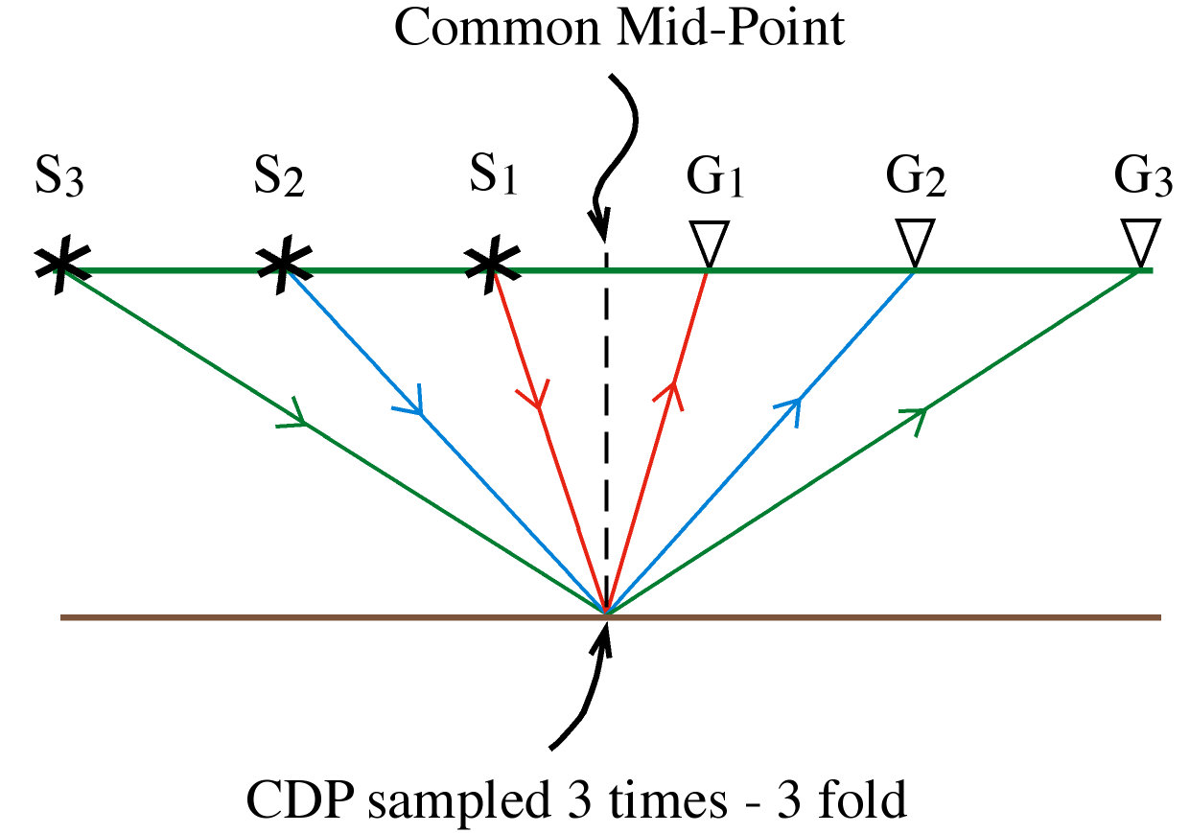
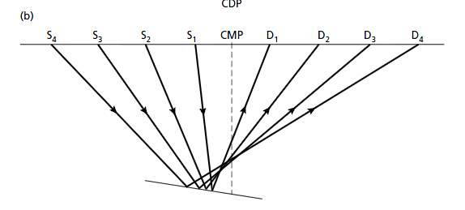
Migration
We can bin data into CDPs, apply an NMO correction to account for source-receiver offset, and then stack each CDP gather.
However, this assumes the Earth comprises layered flat reflector
If the reflector dips, the CDP is NOT directly beneath the CMP, but displaced updip (and no longer same point on the reflector)
Apparent location of CDP

Slide 26
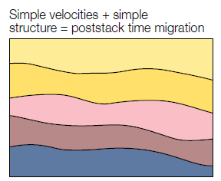
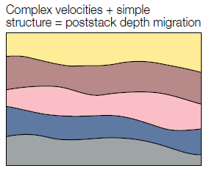
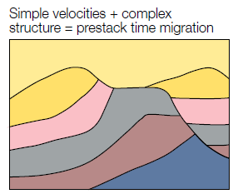
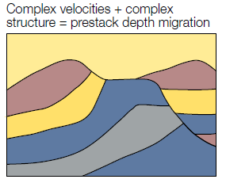
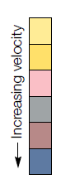
Migration options
Post-stack Migration
Data is migrated after stacking
Assumes geology horizontal
Computationally cheap
Pre-stack Migration
Migration is conducted on unstacked traces
Can account for dipping geology
Computationally expensive (~60-120 times longer than post-stack)
Time Migration
Depth Migration
An accurate 2 or 3D velocity model is required so that moveout curves can be accurately calculated
Farmer et al. 1993
Recommended reading:
Structural Imaging: Toward a Sharper Subsurface View. Farmer et al. Oilfield Review, 1993
Post-stack time migration (cheapest)
Pre-stack depth migration (most expensive)
Pre-stack time migration (perhaps most common)

Slide 27
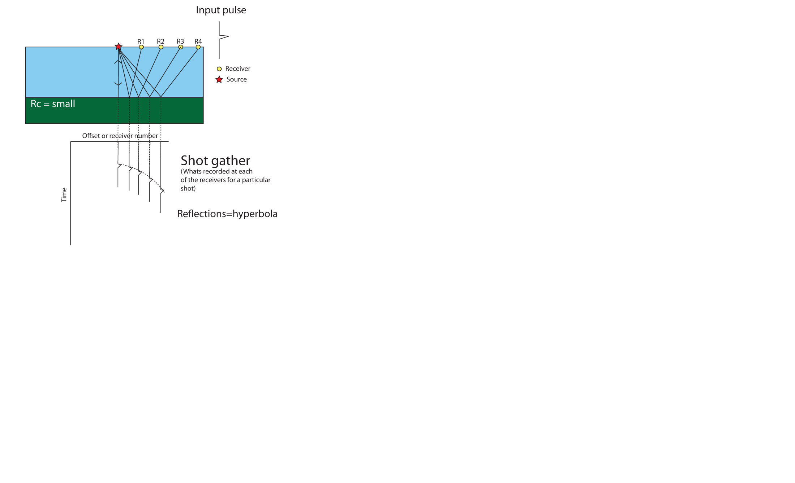
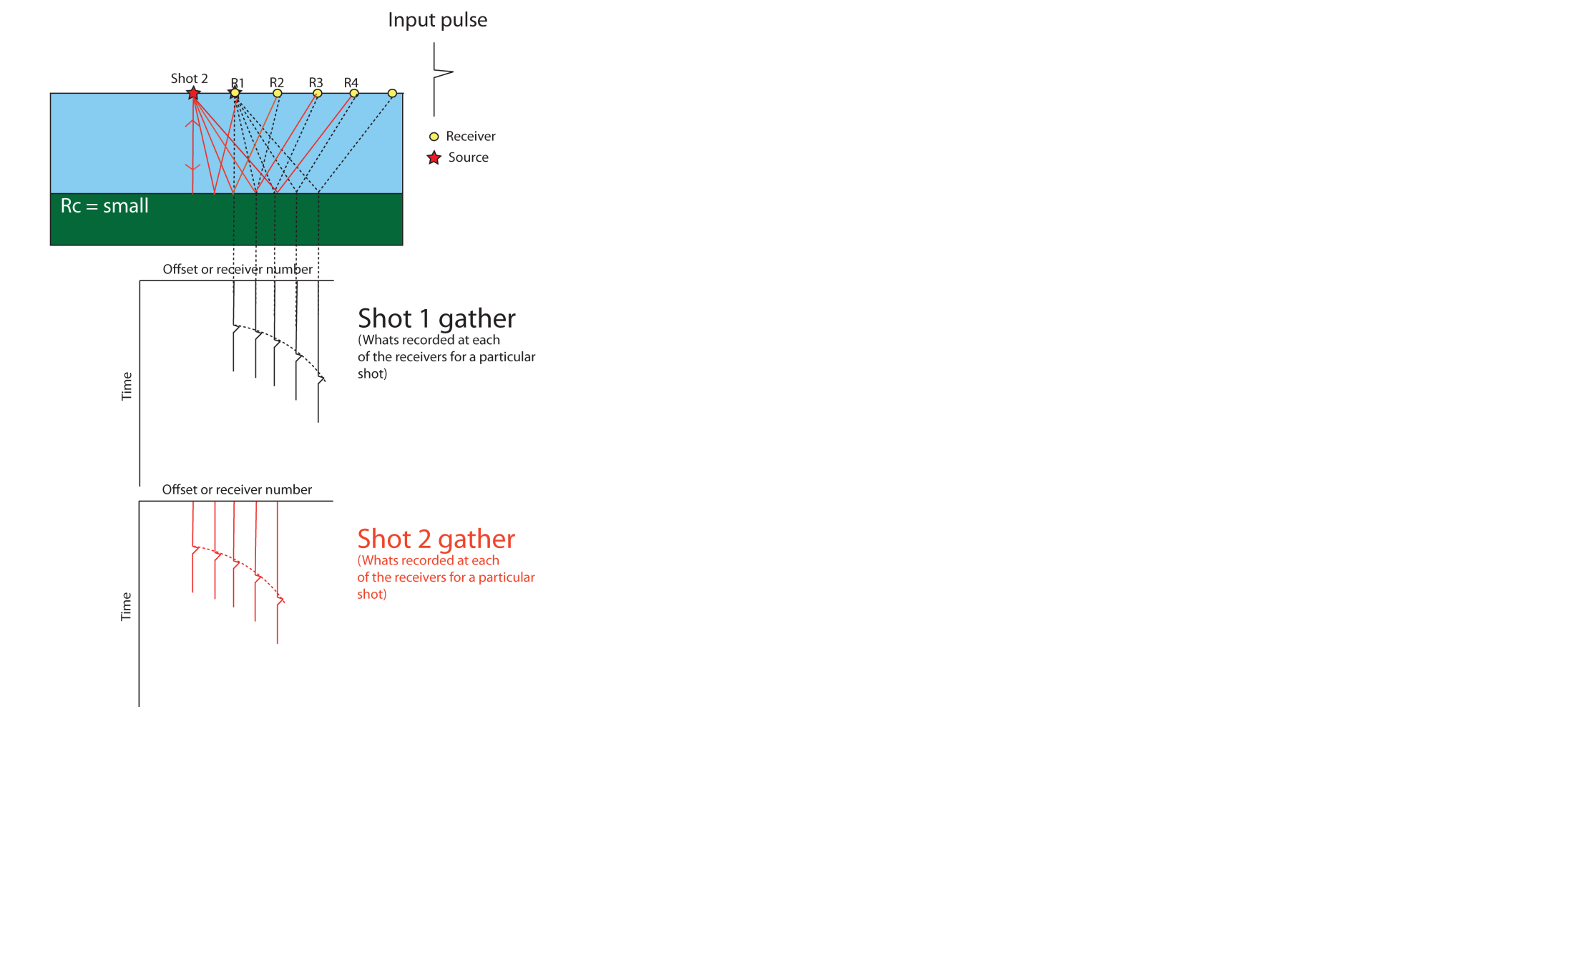

Summary: The Shot gather

Slide 28
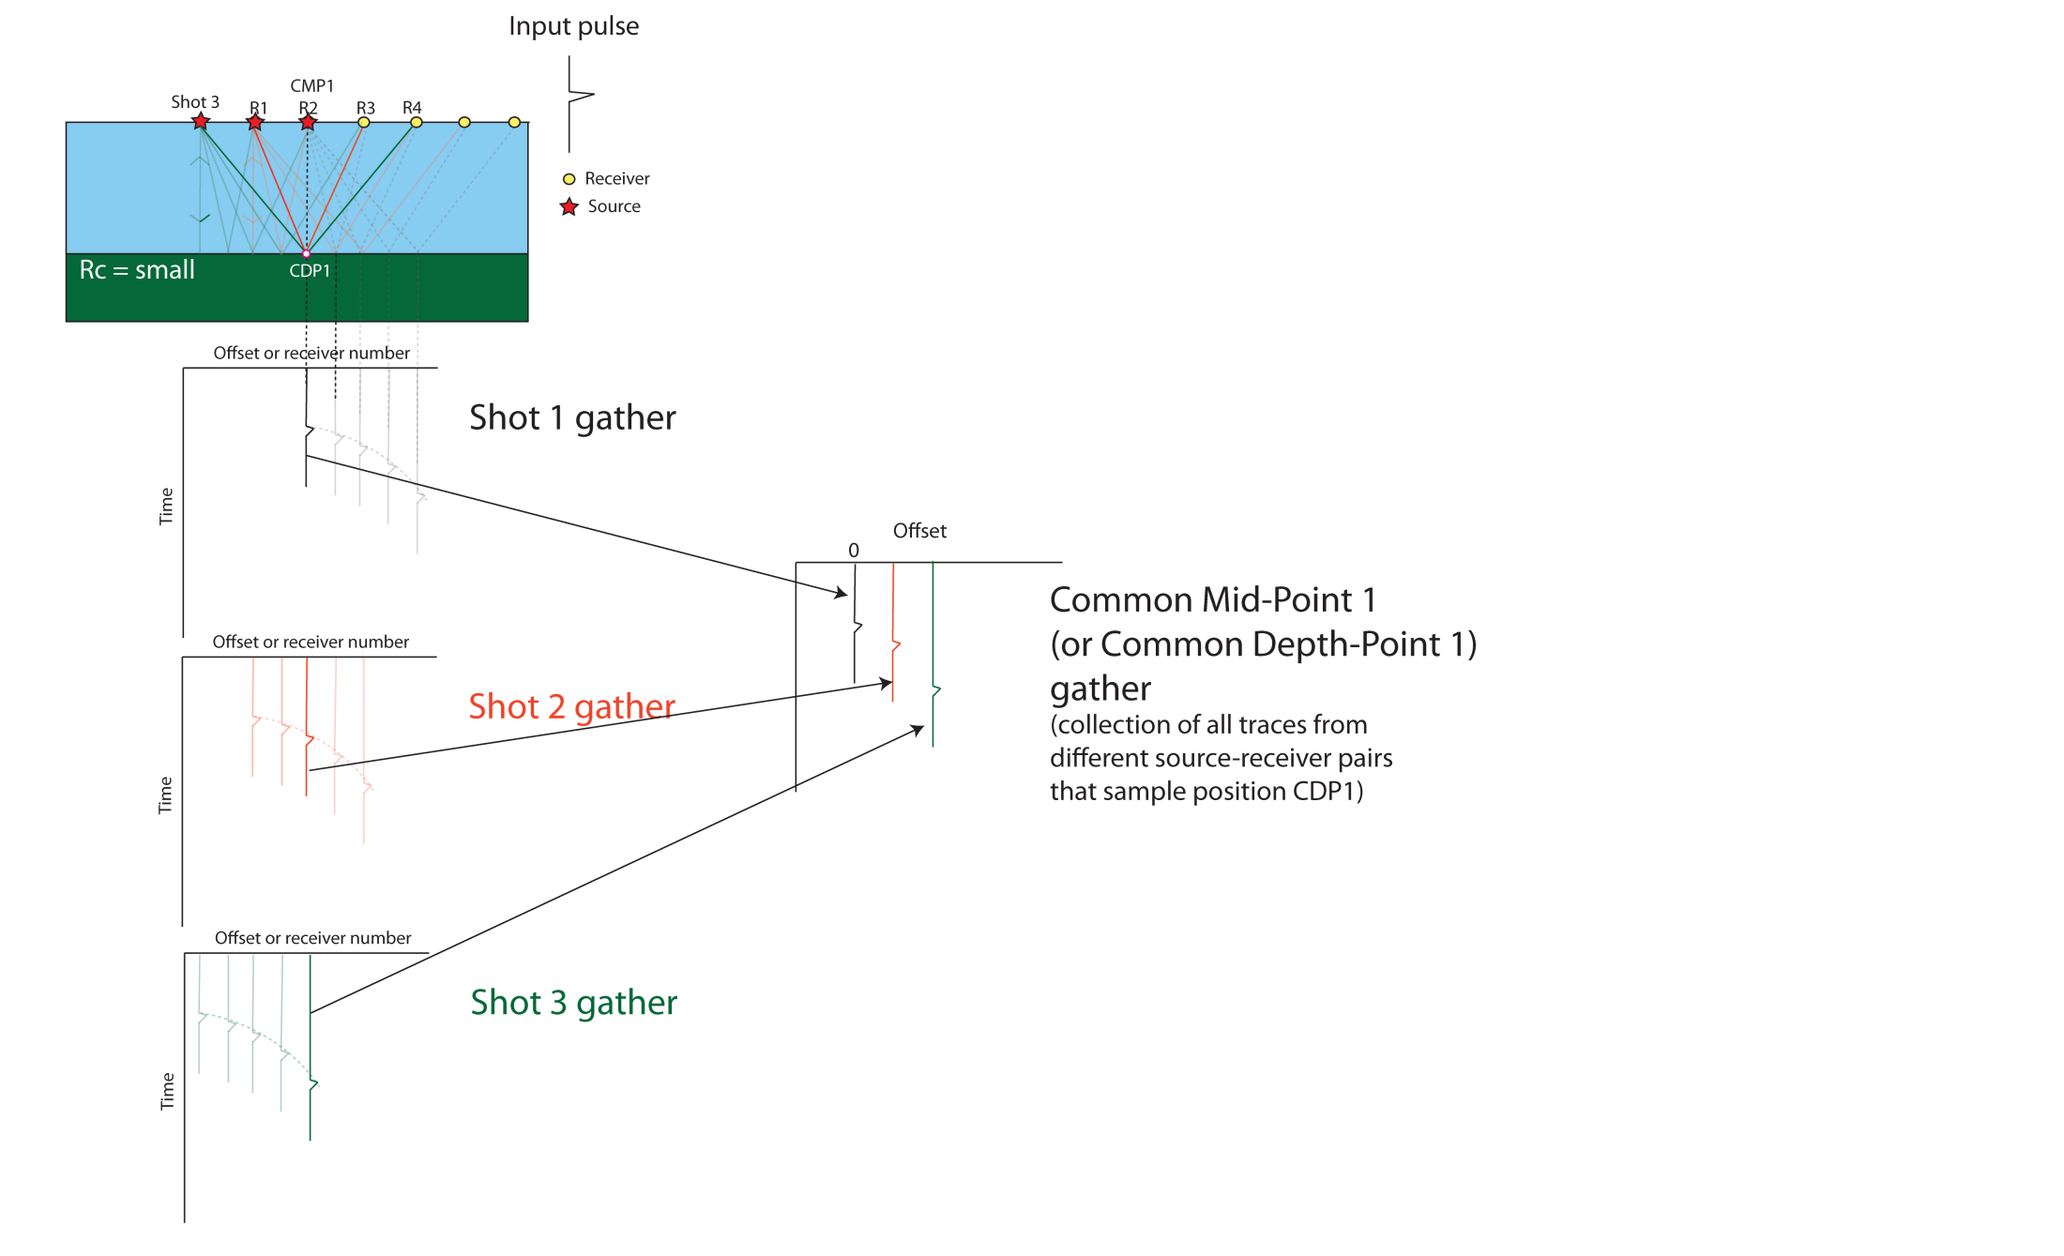
Summary: The CMP/CDP gather

Slide 29
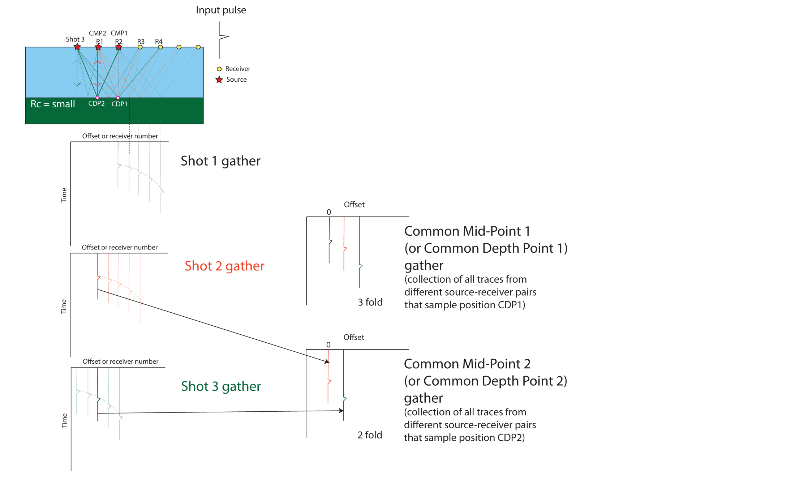
Summary: The CMP/CDP gather

Slide 30

Summary: NMO correction

Slide 31
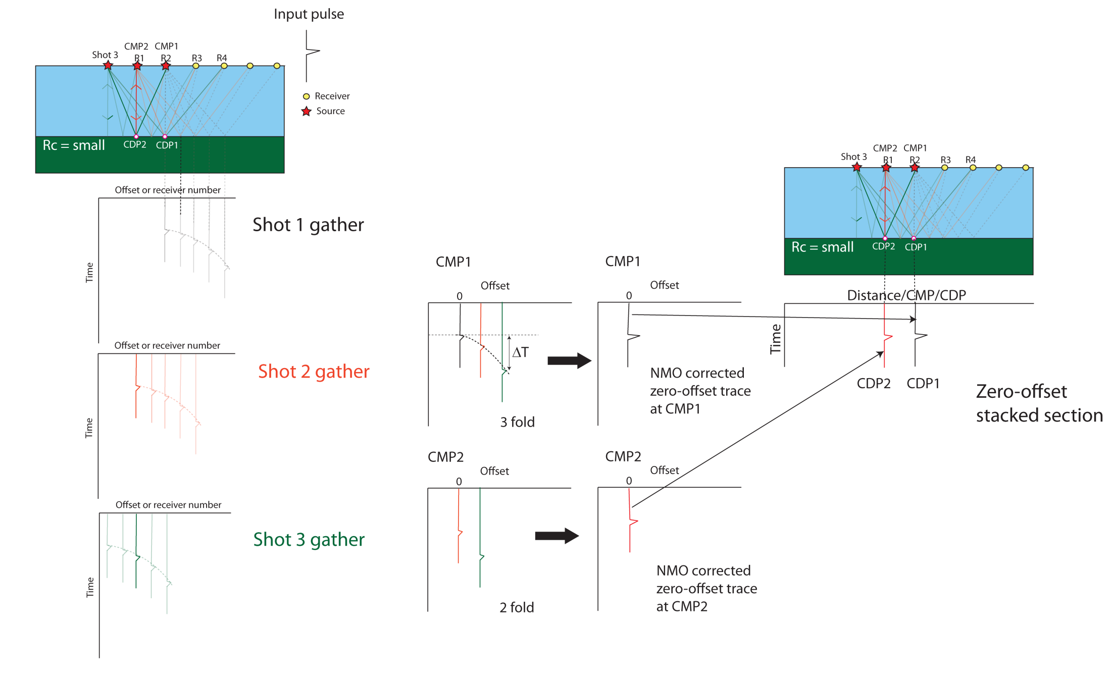
Zero-offset stacked section

Slide 32
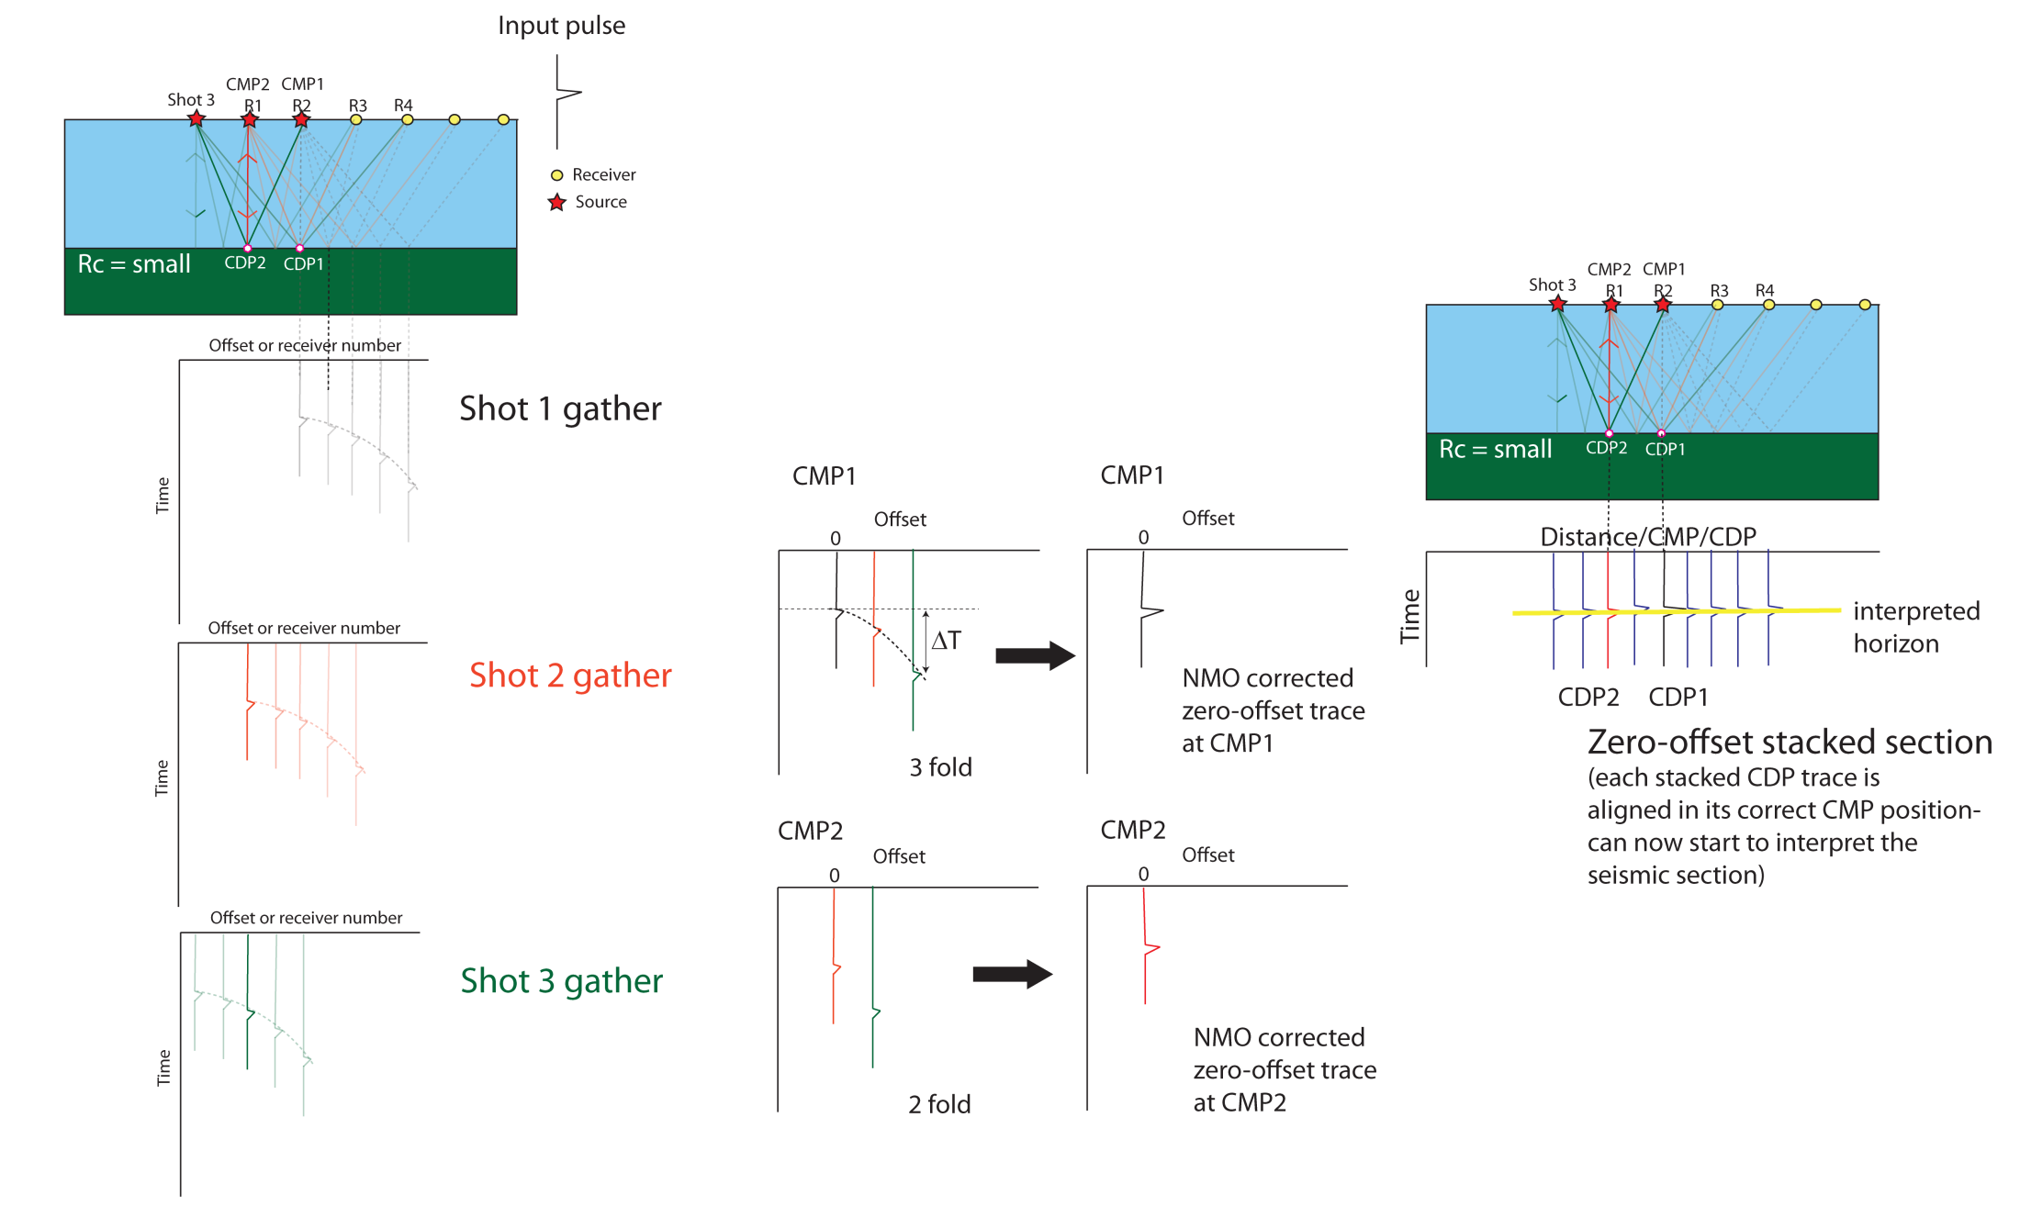
Zero-offset stacked section

Slide 33
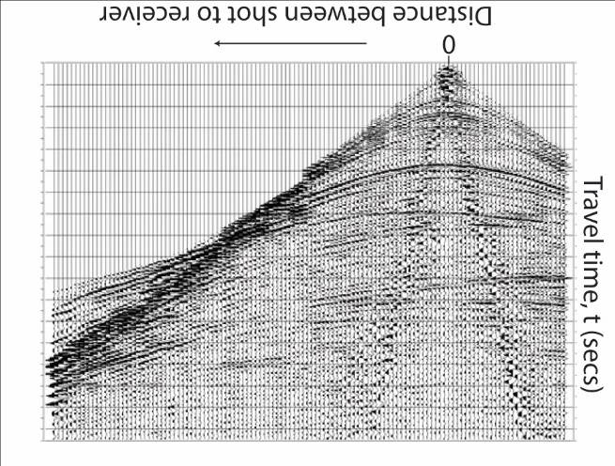
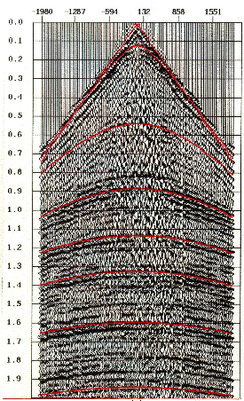
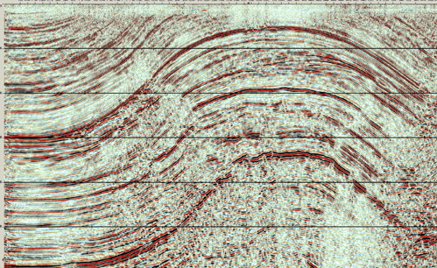
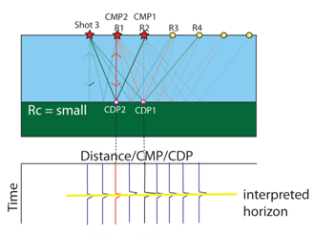


Summary
Shot gathers
Common mid-point gather
Seismic section
Travel time (s)
Travel time (s)
C
CMP/CDP number
Offset between shot and receiver
Straight lines= direct waves/
head waves
Hyperbola= reflections
Images DIFFERENT points in the
sub-surface
Recording from a single shot
Straight lines= direct waves/
head waves
Hyperbola= reflections
Images the SAME point in the
sub-surface (unless dipping)
Compilation from multiple shots
Straight lines= could be bedding….
Curves= could be folds…
Images a cross-section through the
Earth

Slide 34


This is a CMP gather for an offshore survey
What is arrival A (red line)?
1) Geological horizon dipping from left to right
2) Reflection from the seabed
3) The direct wave travelling close to the sea surface

Slide 35

This is a seismic section. What is the feature interpreted in yellow?
1) An anticline
2) A reflection from a horizontal layer, which
has not been NMO corrected
3) A reflection from a dipping layer, which
Has not been NMO corrected

Slide 36
Learning outcomes
By the end of this lecture you should:
Understand the difference between Shot gathers, CMP gathers and stacked seismic sections
2) Appreciate the importance of velocity analysis and NMO corrections as a fundamental step in seismic reflection data processing
3) Appreciate that it is important to know whether the data you download has been migrated, and whether it is post- or pre-stack migrated and time- or depth-migrated
Thanks to: Yanghua Wang, Jenny Collier, Lidia Lonergan, Jo Morgan from Imperial College London, Chris Jackson from
the University of Manchester and Mark Vardy from SAND Geophysics for contributing material for this lecture series

